Slide 1
Software quality assurance
Christos Nanos

Slide 2
Definition
Software Quality Assurance (SQA) is a process that ensures the developed software meets and complies with defined or standardised quality specifications.
It is an ongoing process within the software development life cycle that routinely checks the developed software to ensure it meets desired quality measures.
Generally works on one or more industry standards that help in building software quality guidelines and implementation strategies. (ISO 9000 and Capability Maturity Model Integration)

Slide 3

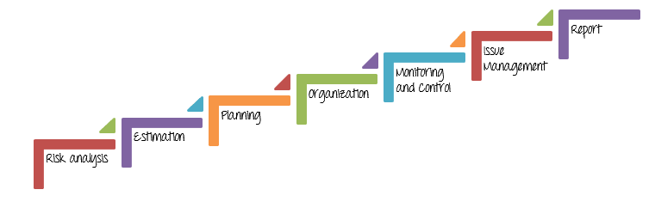
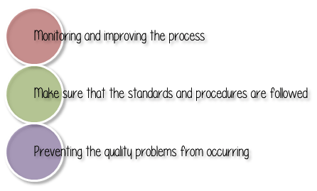
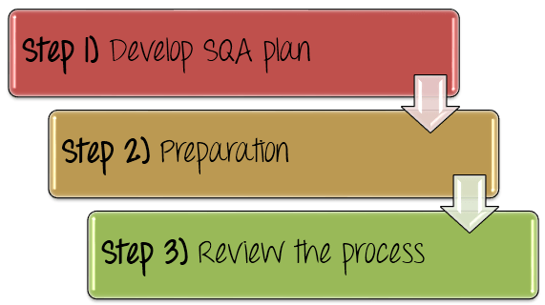
SQA in Test management process

Slide 4
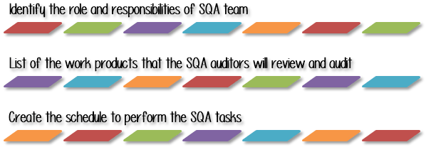
Step 1: Develop A SQA Plan
In a project team, every member must have responsibility for the quality of his or her work. Each person has to make sure their work meet the QA criteria.
List out all the work products of each Test Management Process. Define, which facilities or equipment the SQA auditor has access to perform SQA tasks in, such as process evaluations and audits.
Normally, the SQA schedule is driven by the project development schedule. Therefore, an SQA task is performed in relationship to what software development activities are taking place.

Slide 5
Step2: Define the standards/methodology
Define the policies and procedures intended to prevent defects from occurring in the management process.
Document the policies and procedures.
Inform and train the staff to use it.

Slide 6
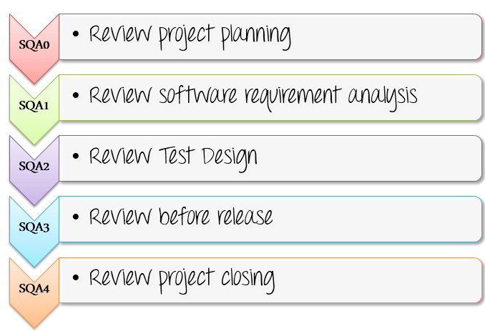
Step 3: Review the process

Slide 7
Best practice
Continuous improvement: All the standard process in SQA must be improved frequently and made official so that the other can follow. This process should be certified by popular organization such as ISO, CMMI… etc.
Documentation: All the QA policies and methods, which are defined by QA team, should be documented for training and reuse for future projects.
Experience: Choosing the members who are seasoned SQA auditors is a good way to ensure the quality of management review
Tool Usage: Utilizing tool such as the tracking tool, management tool for SQA process reduces SQA effort and project cost.
Metrics: Developing and creating metrics to track the software quality in its current state, as well as to compare the improvement with previous versions, will help increase the value and maturity of the Testing process.
Responsibility: The SQA process is not the SQA member’s task, but everyone’s task. Everybody in the team is responsible for quality of product, not just the test lead or manager.

Slide 8
Sources
Software Quality Assurance - Techopedia – url: https://www.techopedia.com/definition/4363/software-quality-assurance-sqa
SQA Test Audit – Guru99 – url: https://www.guru99.com/software-quality-assurance-test-audit-review-makes-your-life-easy.html
QA Project Management – Gurock – url: https://www.gurock.com/testrail/qa-project-management

